Slide 1
Preparing for High-Quality Assessments
The webinar will begin shortly. You may wish to download the handouts (check the tab on your webinar control panel) while you wait.
Core Advocate Webinar
April 19, 2016
7:00 – 8:00 EDT

Slide 2
Introductions
Joanie Funderburk & Janelle Fann, Field Impact Team
Astrid Fossum, afossum@studentsachieve.net
Katie Keown, kkeown@studentsachieve.net
Core Advocates are educators who:
  Believe in the potential of the CCSS to prepare all students for college and careers;
  Are eager to support their colleagues and communities in understanding and advocating for the CCSS and CCSS-aligned instruction;
  Understand and embrace the Shifts in instruction and assessment required by the CCSS

Slide 3
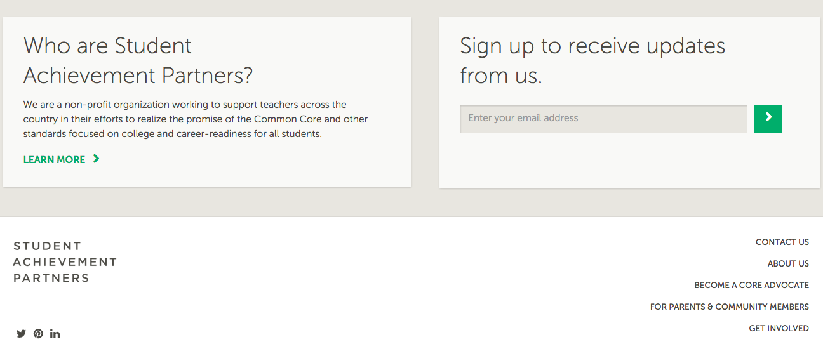
To learn more about Core Advocates…
Contact Janelle Fann (jfann@studentsachieve.net ) or Joanie Funderburk (jfunderburk@studentsachieve.net)
Complete this survey to join our database (and mailing lists): http://bitly.com/joincoreadvocates
Visit our website: www.achievethecore.org

Slide 4

For Tweeters…
Please feel free to tweet during and after the webinar using #coreadvocates
@achievethecore and @JoanieFun, @AstridFossum

Slide 5
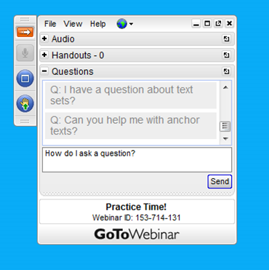
Webinar protocols
During the webinar
– Accessing Documents
– Questions option
– Polling
After the webinar
– Survey
– Access to recorded webinar

Slide 6
Goals of the webinar
Participants will be able to better answer the following questions:
What does high-quality assessment, aligned to the Shifts, look like?
How do I prepare my students for high-quality assessments?
What resources are available to help me?

Slide 7
What does high-quality assessment, aligned to the Shifts, look like?

Slide 8
What is high-quality assessment?
CCSSO Criteria for Procuring and Evaluating High-Quality Assessment
Meet Overall Assessment Goals and Ensure Technical Quality
Align to Standards – English Language Arts/Literacy
Align to Standards – Mathematics
Yield Valuable Reports on Student Progress and Performance
Adhere to Best Practices in Test Administration
State Specific Criteria (as desired)

Slide 9
CCSSO Section B: Align to Standards: English Language Arts/Literacy
Criterion B.1: Assessing student reading and writing achievement in both ELA and literacy
Criterion B.2: Focusing on complexity of texts
Criterion B.3: Requiring students to read closely and use evidence from texts
Criterion B.4: Requiring a range of cognitive demand
Criterion B.5: Assessing writing
Criterion B.6: Emphasizing vocabulary and language skills
Criterion B.7: Assessing research and inquiry
Criterion B.8: Assessing speaking and listening
Criterion B.9: Ensuring high-quality items and a variety of item types

Slide 10
The Literacy Shifts
Regular practice with complex text and its academic language.
Reading, writing, and speaking grounded in evidence from text, both literary and informational.
Building knowledge through content-rich nonfiction.

Slide 11
Where do you see the Shifts?
Criterion B3: Requiring students to read closely and use evidence from texts:
Reading assessments consist of test questions or tasks, as appropriate, that demand that students read carefully and deeply and use specific evidence from increasingly complex texts to obtain and defend correct responses.

Slide 12
Where do you see the Shifts?
Criterion B3: Requiring students to read closely and use evidence from texts:
Reading assessments consist of test questions or tasks, as appropriate, that demand that students read carefully and deeply and use specific evidence from increasingly complex texts to obtain and defend correct responses.

Slide 13
Where do you see the Shifts?
Criterion B3: Requiring students to read closely and use evidence from texts:
Reading assessments consist of test questions or tasks, as appropriate, that demand that students read carefully and deeply and use specific evidence from increasingly complex texts to obtain and defend correct responses.

Slide 14
The Criteria and the Shifts
CCSSO Criterion | Most Tightly Aligned Literacy Shift
Criterion B.1 | Shift 3 (ELA/Literacy should include both informational and literary texts, with an increased emphasis on informational texts as students progress through the grades) And remember, these Criteria are about high-quality so texts should be worthy of students’ attention.
Criterion B.2 | Shift 1 (complex text, as one cannot measure student achievement unless the texts are appropriate for the grade level)
Criterion B.3 | Shift 2 (Reading, writing and speaking grounded in evidence from text, both literary and informational)
Criterion B.4 | Shifts 1, 2, and 3 text-based questions (both informational and literary driven) should range from less demanding to very demanding to allow teachers to gather information on the range of students in their classrooms
Criterion B.5 | Shifts 1 and 2 (Writing is text-based and requires use of evidence) and in some cases Shift 3 (content-rich nonfiction).

Slide 15
The Criteria and the Shifts
CCSSO Criterion | Most Tightly Aligned Literacy Shift
Criterion B.6 | Shift 1 (academic language is specifically called out in the Shift) and Shift 2 (because the academic language should be surrounded by strong context in informational or literary text)
Criterion B.7 | Shift 3 (as research should be conducted using multiple content-rich informational texts), Shift 2, (as students use evidence in research), and Shift 1) because the texts should be appropriately complex).
Criterion B.8 | Shift 1 (as stimuli for listening should be appropriately complex), and Shift 2 (use of evidence is applicable to all domains, including listening and speaking)
Criterion B.9 | Shifts 1, 2, and 3. Text-based questions on appropriately complex informational and literary texts should focus on use of evidence and be high-quality questions worth asking.

Slide 16
CCSSO Section C: Align to Standards: Mathematics
Criterion C.1: Focusing strongly on the content most needed for success in later mathematics
Criterion C.2: Assessing a balance of concepts, procedures, and applications
Criterion C.3: Connecting practice to content
Criterion C.4: Requiring a range of cognitive demand
Criterion C.5: Ensuring high-quality items and a variety of item types

Slide 17
The CCSS Requires Three Shifts in Mathematics (Instruction and Assessment)
Focus: Focus strongly where the Standards focus.
Coherence: Think across grades, and link to major topics within grades.
Rigor: In major topics, pursue conceptual understanding, procedural skill and fluency, and application.

Slide 18
Where do you see the Shifts?
C.1 Focusing strongly on the content most needed for success in later mathematics:
The assessments help educators keep students on track to readiness by focusing strongly on the content most needed in each grade or course for later mathematics.

Slide 19
Where do you see the Shifts?
C.1 Focusing strongly on the content most needed for success in later mathematics:
The assessments help educators keep students on track to readiness by focusing strongly on the content most needed in each grade or course for later mathematics.

Slide 20
Where do you see the Shifts?
C.2 Assessing a balance of concepts, procedures, and applications: The assessments measure conceptual understanding, fluency and procedural skill, and application of mathematics, as set out in college- and career-ready standards.

Slide 21
Where do you see the Shifts?
C.2 Assessing a balance of concepts, procedures, and applications: The assessments measure conceptual understanding, fluency and procedural skill, and application of mathematics, as set out in college- and career-ready standards.

Slide 22
The Criteria and the Shifts
CCSSO Criterion | Most Tightly Aligned Mathematics Shift
Criterion C.1 | Shift of Focus: Focus strongly where the Standards focus
Criterion C.2 | Shift of Rigor: In major topics, pursue conceptual understanding, procedural skill and fluency, and application.
Criterion C.3 | Shift of Coherence: Think across grades, and link to major topics within grades. Practices should be meaningful and connect to content standards, ideally to the content for success in later mathematics.
Criterion C.4 | Shifts of Focus, Coherence, and Rigor: Problems should range from less demanding to very demanding to allow teachers to gather information on the range of students in their classrooms
Criterion C.5 | Shifts of Focus, Coherence and Rigor: A variety of item types and items free from mathematical inaccuracy

Slide 23
Poll:
How connected are your assessments to the Shifts and the Criteria?

Slide 24
How do I prepare my students for high- quality assessments?

Slide 25
Question:
What are you currently doing to prepare your students for Summative Assessments?
Use the Questions tab on your control panel to submit your response.

Slide 26
How do I prepare my students? ELA item comparison
Traditional Item
Next-Generation Item
What are the two texts mostly about?
A. child labor*
B. friendship
C. the importance of education
D. the need for independence
Part A: In Text 1, how does Arthur respond when Miss Lesley asks Grace to help with the letter?
A.He worries that Grace may reveal that Miss Lesley helped write the letter.*
B.He appreciates that Grace is helping him think of details to include in the letter.
C.He believes Grace will help make the activity go faster so they can get back to work.
D.He thinks it is good for Grace to learn about the Child Labor Committee.
Part B: Which sentence from Text 1 best shows Arthur’s reaction?
A.“Grace, hush for once in your life and listen.”
B.“That’s as far as we got,” Arthur says.
C.“Stop arguing,” Arthur says to me.
D.“You’d better not tell.”*

Slide 27
Preparing Students for ELA Assessments with the Shifts
In your instruction:
Expose students to high-quality, appropriately complex texts
Require students use evidence to support their answers in both classroom discussion and writing
On your assessments:
Expose students to high-quality, appropriately complex texts
Expose students to a variety of item types (especially Evidence Based Selected Response Items)

Slide 28
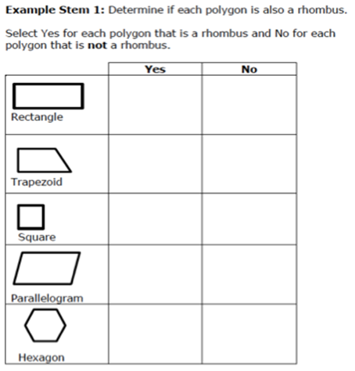
How do I prepare my students? Math item comparison
Next-Generation Item
Traditional Item
Multiple Choice (Grade 5)Grade
Which word below describes a
parallelogram with sides of equal
length and four right angles?
A.Rectangle
B.Rhombus
C.Square
D.Trapezoid
Multiple Choice (Grade 5)

Slide 29
Preparing students for Math Assessments with the Shifts
In your instruction...
Focus on the content most needed for success in later mathematics (major work of the grade, widely-applicable prerequisites)
Spend equal time teaching and engaging students with concepts that require conceptual understanding, procedural skill/fluency and application
Connect supporting content to major topics
On your assessments…
Balance conceptual understanding, procedural skill/fluency and application items
Expose students to a variety of item types

Slide 30
Question:
How has your view of preparing for assessments changed?
Use the Question tab on your control panel to submit your response.

Slide 31
What resources are available to help me?

Slide 32
What SAP Resources are available to help me?
Tool | Potential Uses
SAP Mini-Assessments (ELA and Math) | Expose your students to high-quality assessment Expose your students to a variety of item types
Assessment Evaluation Tool (AET) | Evaluate an assessment or assessment system to determine if it is worthy of your students time and attention
Item Quality Checklists | Determine if an individual test passage (ELA) or item (ELA and math) aligns to the Shifts and major features of the CCSS Guide for individual item creation
The Shifts in Assessment PowerPoint (ELA and Math) | Professional development regarding aligned assessment

Slide 33
What Additional Free Assessment Resources are Available to Help Me?
SMARTER Practice Tests
PARCC Practice Tests

Slide 34
Poll:
Which resource will you investigate in the next week to learn more about High-Quality Assessments?

Slide 35
What questions do you have?

Slide 36
Follow Up
Give a mini-assessment in your class
Use the passage/item quality criteria checklist on one of your upcoming assessments to determine if it is worthy of student time/attention.
Partner with SAP to use a mini-assessment with your students and provide feedback about mini-assessment administration - contact Katie if you’re interested!
Tell us about it!

Slide 37
Upcoming Webinars
May webinar:
Instructional Materials Make a Difference: Why We Should Spend More Time Choosing and How You Can Play a Role
Tuesday, May 24, 2016 7:00 - 8:00 pm EDT
Register here: https://attendee.gotowebinar.com/register/6556906080307412483

Slide 38
Thank You!

Slide 39
Resources
www.Achievethecore.org
Submit your action steps here http://bit.ly/1EYfuMQ

